Slide 1
Encryption
CH# 08
By: Ramsha kumari
Chandni Rai

Slide 2
agenda
Encryption introduction
Decryption
methods of encryption
Legitimate vs fraudulent encryption
Cryptography
types
Difference between cryptography and encryption
Tools

Slide 3
Encryption
Encryption is the process by which a readable message is converted to an unreadable form to prevent unauthorized parties from reading it.
It is fundamental application of cryptography by which information is converted into secret code that hides the information's true meaning.
Majorly used to protect private information, sensitive data, and help to enhance security.

Slide 4
Decryption
It is the process that converts back the encrypted text in plain/original form.
It decodes the encrypted information so that an authorized user can only decrypt the data because decryption requires a secret key or password.

Slide 5
Methods of encryption:
The Caesar Cipher:
choose some number by which to shift each letter of a text:
For example: “Cyber”
choose to shift by two letters, then the message becomes: Eadgt
choose to shift by three letters, then the message becomes: fbehu

Slide 6
Methods of encryption:
2. Multi-Alphabet Substitution:
a slight improvement on the Caesar cipher
Select multiple shifts like Shift (-1, 1, 2)
Rotate through the shifts : Graduation → Fsccvcsjqm
Select multiple shifts like Shift (1, 2, –1)
Rotate through the shifts : A DOG → B FNH

Slide 7
Methods of encryption:
3. Binary Operations: (AND, OR, and XOR)
1 1 0 1 1 1 0 1 0 1 0 0
1 0 0 1 1 0 0 1 1 0 0 1
=1 0 0 1 =1 1 0 1 =1 1 0 1
And OR XOR

Slide 8
XOR working:
XOR only reversible binary operation
First it Converts plain text to ASCII
Like:
A DOG = 065 032 068 079 071
Then, convert ASCII to binary:
0100 0001, 0100 0100, 0100 1111, 0100 0111

Slide 9
Legitimate Vs fraudulent Encryption Methods.
Digital signatures
Hashing

Slide 10
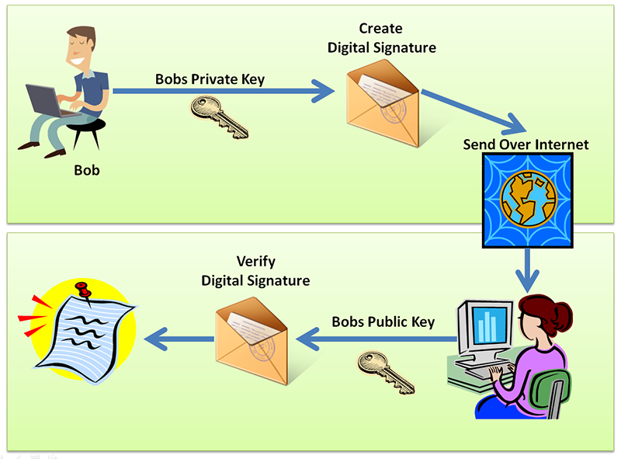
Digital signature
The purpose of a digital signature is to confirm who sent a message, not to protect its confidentiality.
Process of digital signature is reverse the process of asymmetric encryption.
With a digital signature, the sender encrypts something with his or her private key. if the recipient can decrypt the message using the sender's public key then It must have been sent by the person who is supposed to have sent the message.
Example: email signature that we often add at the end of the email,

Slide 11
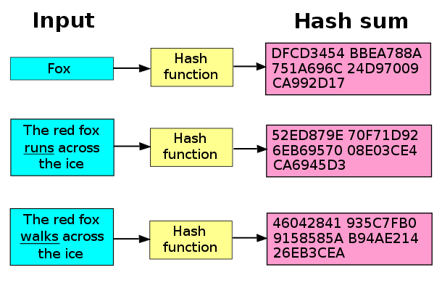
Hashing:
It is a type of cryptographic algorithm
It is one-way that means you cannot unhash something
you get a fixed-length output no matter what input is given.
Hash algorithms are: MD5, SHA1, SHA2, SHA3

Slide 12
Cryptography
Cryptography is the practice of converting messages in a way that is hard to decode, using mathematical algorithms and mathematical concepts.
A cryptographic system is used to secure information and communication by encoding them so that only those intended for the information can decode it and utilize it.
Cryptography means ‘hidden writing’

Slide 13
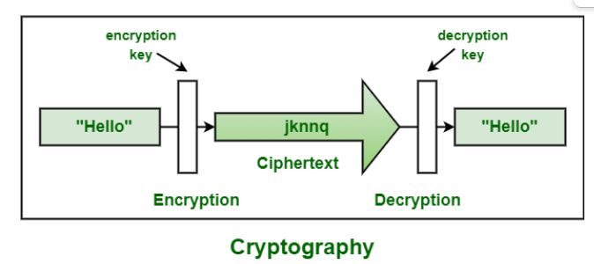

Slide 14
Types of Cryptography
Symmetric key cryptography
Hash Functions
Asymmetric key cryptography

Slide 15
Symmetric Key Cryptography
Encrypt and decrypt messages by using a single key shared by the sender and receiver.
Symmetric Key Systems are faster and simpler but the problem is that sender and receiver have to somehow exchange key in a secure manner.
The most popular symmetric key cryptography system is Data Encryption System(DES).

Slide 16
Hash Functions
Not any key is used in this algorithm.
A hash value with fixed length is calculated as per the plain text which makes it impossible for contents of plain text to be recovered.
Many operating systems use hash functions to encrypt passwords.

Slide 17
Asymmetric Key Cryptography
A pair of keys is used to encrypt and decrypt information.
A public key is used for encryption and a private key is used for decryption.
A receiver can only decode a public key he only knows because he has access to the private key.
RSA algorithm uses a pair of keys.
Public key cryptography is similar to asymmetric key encryption, and it uses public and private keys to encrypt and decrypt messages.

Slide 18
Encryption Vs Cryptography
It is the process of converting plain text into a cypher, which can’t be figured out without a key.
Encryption is a smaller term that comes under Cryptography..
It is all about mathematics and algorithmic in nature.
Cryptography means securing a message using the encryption and decryption method.
Cryptography comprises the term Encryption in it as it’s a part of the Cryptography process.
It is all about techniques and technologies in nature.

Slide 19
Tools:
https://www.devglan.com/online-tools/text-encryption-decryption
https://www.md5hashgenerator.com/ (Md5 hash generator )

Slide 20
Thankyou ☺

